Slide 1

Module 5: Number Systems
Introduction to Networks v7.0 (ITN)

Slide 2
Module Objectives
Module Title: Number Systems
Module Objective: Calculate numbers between decimal, binary, and hexadecimal systems.
Topic Title | Topic Objective
Binary Number System | Calculate numbers between decimal and binary systems.
Hexadecimal Number System | Calculate numbers between decimal and hexadecimal systems.

Slide 3
5.1 Binary Number System

Slide 4
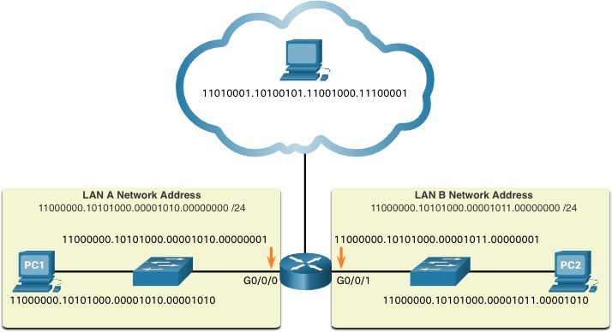
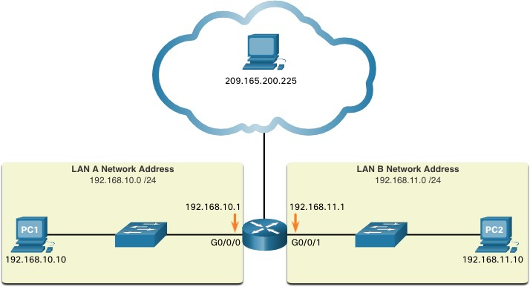
Binary and IPv4 Addresses
Binary Number System
Binary numbering system consists of 1s and 0s, called bits
Decimal numbering system consists of digits 0 through 9
Hosts, servers, and network equipment using binary addressing to identify each other.
Each address is made up of a string of 32 bits, divided into four sections called octets.
Each octet contains 8 bits (or 1 byte) separated by a dot.
For ease of use by people, this dotted notation is converted to dotted decimal.

Slide 5
Video – Convert Between Binary and Decimal Numbering Systems
Binary Number System
This video will cover the following:
Positional notation review
Powers of 10 review
Decimal – base 10 numbering review
Binary – base 2 numbering review
Convert an P address in binary to decimal numbering

Slide 6
Binary Positional Notation
Binary Number System
Positional notation means that a digit represents different values depending on the “position” the digit occupies in the sequence of numbers.
The decimal positional notation system operates as shown in the tables below.
 | Thousands | Hundreds | Tens | Ones
Positional Value | 1000 | 100 | 10 | 1
Decimal Number (1234) | 1 | 2 | 3 | 4
Calculate | 1 x 1000 | 2 x 100 | 3 x 10 | 4 x 1
Add them up… | 1000 | + 200 | + 30 | + 4
Result | 1,234
Radix | 10 | 10 | 10 | 10
Position in Number | 3 | 2 | 1 | 0
Calculate | (10³) | (10²) | (10¹) | (10⁰)
Position Value | 1000 | 100 | 10 | 1

Slide 7
Binary Number System
Binary Positional Notation (Cont.)
The binary positional notation system operates as shown in the tables below.
Radix | 2 | 2 | 2 | 2 | 2 | 2 | 2 | 2
Position in Number | 7 | 6 | 5 | 4 | 3 | 2 | 1 | 0
Calculate | (2⁷) | (2⁶) | (2⁵) | (2⁴) | (2³) | (2²) | (2¹) | (2⁰)
Position Value | 128 | 64 | 32 | 16 | 8 | 4 | 2 | 1
Positional Value | 128 | 64 | 32 | 16 | 8 | 4 | 2 | 1
Binary Number (11000000) | 1 | 1 | 0 | 0 | 0 | 0 | 0 | 0
Calculate | 1x128 | 1x64 | 0x32 | 0x16 | 0x8 | 0x4 | 0x2 | 0x1
Add Them Up… | 128 | + 64 | + 0 | + 0 | + 0 | + 0 | + 0 | + 0
Result | 192

Slide 8
Binary Number System
Convert Binary to Decimal
Convert 11000000.10101000.00001011.00001010 to decimal.
Positional Value | 128 | 64 | 32 | 16 | 8 | 4 | 2 | 1
Binary Number (11000000) | 1 | 1 | 0 | 0 | 0 | 0 | 0 | 0
Calculate | 1x128 | 1x64 | 0x32 | 0x16 | 0x8 | 0x4 | 0x2 | 0x1
Add Them Up… | 128 | + 64 | + 0 | + 0 | + 0 | + 0 | + 0 | + 0
Binary Number (10101000) | 1 | 0 | 1 | 0 | 1 | 0 | 0 | 0
Calculate | 1x128 | 0x64 | 1x32 | 0x16 | 1x8 | 0x4 | 0x2 | 0x1
Add Them Up… | 128 | + 0 | + 32 | + 0 | + 8 | + 0 | + 0 | + 0
Binary Number (00001011) | 0 | 0 | 0 | 0 | 1 | 0 | 1 | 1
Calculate | 0x128 | 0x64 | 0x32 | 0x16 | 1x8 | 0x4 | 1x2 | 1x1
Add Them Up… | 0 | + 0 | + 0 | + 0 | + 8 | + 0 | + 2 | + 1
Binary Number (00001010) | 0 | 0 | 0 | 0 | 1 | 0 | 1 | 0
Calculate | 0x128 | 0x64 | 0x32 | 0x16 | 1x8 | 0x4 | 1x2 | 0x1
Add Them Up… | 0 | + 0 | + 0 | + 0 | + 8 | + 0 | + 2 | + 0
192
168
192.168.11.10
11
10

Slide 9
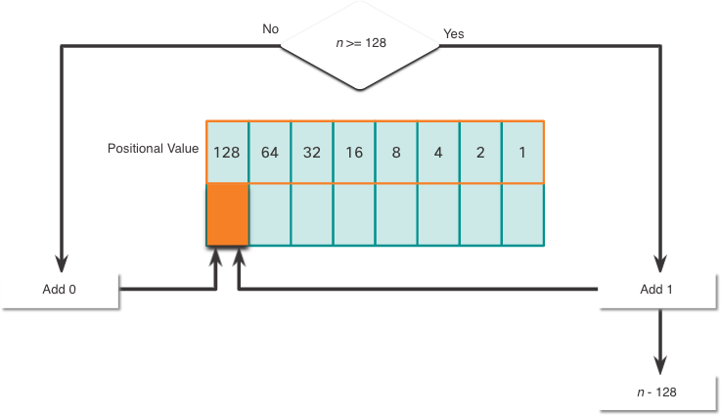
Binary Number System
Decimal to Binary Conversion
The binary positional value table is useful in converting a dotted decimal IPv4 address to binary.
Start in the 128 position (the most significant bit). Is the decimal number of the octet (n) equal to or greater than 128?
If no, record a binary 0 in the 128 positional value and move to the 64 positional value.
If yes, record a binary 1 in the 128 positional value, subtract 128 from the decimal number, and move to the 64 positional value.
Repeat these steps through the 1
positional value.

Slide 10
Decimal to Binary Conversion Example
Binary Number System
Convert decimal 168 to binary
Is 168 > 128?
Yes, enter 1 in 128 position and subtract 128 (168-128=40)
Is 40 > 64?
No, enter 0 in 64 position and move on Is 40 > 32?
Yes, enter 1 in 32 position and subtract 32 (40-32=8)
Is 8 > 16?
No, enter 0 in 16 position and move on Is 8 > 8?
Equal. Enter 1 in 8 position and subtract 8 (8-8=0) No values left. Enter 0 in remaining binary positions
128 | 64 | 32 | 16 | 8 | 4 | 2 | 1
1 | 0 | 1 | 0 | 1 | 0 | 0 | 0
Decimal 168 is written as 10101000 in binary

Slide 11
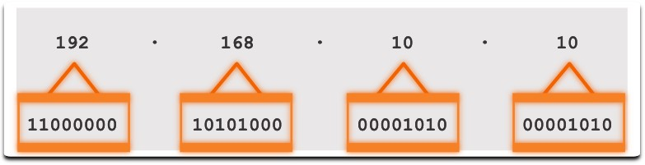
IPv4 Addresses
Binary Number System
Routers and computers only understand binary, while humans work in decimal. It is important for you to gain a thorough understanding of these two numbering systems and how they are used in networking.

Slide 12
5.2 Hexadecimal Number System

Slide 13
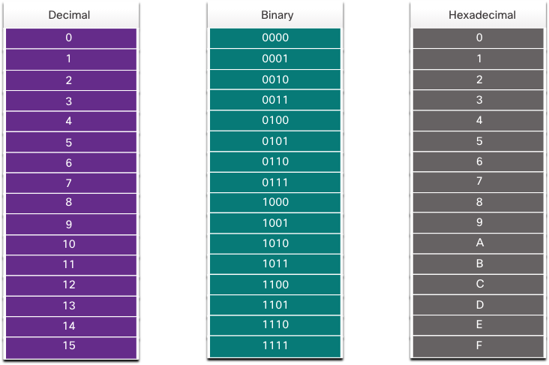
Hexadecimal and IPv6 Addresses
Hexadecimal Number System
To understand IPv6 addresses, you must be able to convert hexadecimal to decimal and vice versa.
Hexadecimal is a base sixteen numbering system, using the digits 0 through 9 and letters A to F.
It is easier to express a value as a single hexadecimal digit than as four binary bit.
Hexadecimal is used to represent IPv6 addresses and MAC addresses.

Slide 14
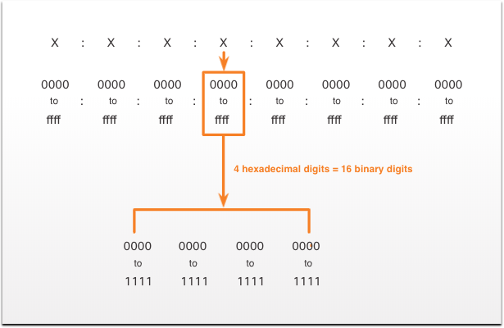
Hexadecimal and IPv6 Addresses (Cont.)
Hexadecimal Number System
IPv6 addresses are 128 bits in length. Every 4 bits is represented by a single hexadecimal digit. That makes the IPv6 address a total of 32 hexadecimal values.
The figure shows the preferred method of writing out an IPv6 address, with each X representing four hexadecimal values.
Each four hexadecimal character group is referred to as a hextet.

Slide 15
Video – Converting Between Hexadecimal and Decimal Numbering Systems
Hexadecimal Number System
This video will cover the following:
Characteristics of the Hexadecimal System
Convert from Hexadecimal to Decimal
Convert from Decimal to Hexadecimal

Slide 16
Decimal to Hexadecimal Conversions
Hexadecimal Number System
Follow the steps listed to convert decimal numbers to hexadecimal values:
Convert the decimal number to 8-bit binary strings.
Divide the binary strings in groups of four starting from the rightmost position.
Convert each four binary numbers into their equivalent hexadecimal digit.
For example, 168 converted into hex using the three-step process.
168 in binary is 10101000.
10101000 in two groups of four binary digits is 1010 and 1000.
1010 is hex A and 1000 is hex 8, so 168 is A8 in hexadecimal.

Slide 17
Hexadecimal to Decimal Conversions
Hexadecimal Number System
Follow the steps listed to convert hexadecimal numbers to decimal values:
Convert the hexadecimal number to 4-bit binary strings.
Create 8-bit binary grouping starting from the rightmost position.
Convert each 8-bit binary grouping into their equivalent decimal digit.
For example, D2 converted into decimal using the three-step process:
D2 in 4-bit binary strings is 1110 and 0010.
1110 and 0010 is 11100010 in an 8-bit grouping.
11100010 in binary is equivalent to 210 in decimal, so D2 is 210 is decimal

Slide 18
5.3 Module Practice and Quiz

Slide 19
What did I learn in this module?
Module Practice and Quiz
Binary is a base two numbering system that consists of the numbers 0 and 1, called bits.
Decimal is a base ten numbering system that consists of the numbers 0 through 9.
Binary is what hosts, servers, and networking equipment uses to identify each other.
Hexadecimal is a base sixteen numbering system that consists of the numbers 0 through 9 and the letters A to F.
Hexadecimal is used to represent IPv6 addresses and MAC addresses.
IPv6 addresses are 128 bits long, and every 4 bits is represented by a hexadecimal digit for a total of 32 hexadecimal digits.
To convert hexadecimal to decimal, you must first convert the hexadecimal to binary, then convert the binary to decimal.
To convert decimal to hexadecimal, you must first convert the decimal to binary and then the binary to hexadecimal.

Slide 20


